Slide 1







2nd Data Science & AI Summer School 2025
Statistics for Machine Learning
Instructors: Joseph Luper Tsenum, Alexander Takele Mengesha and Andrew Balincura
Teaching Assistant (TA): Emmanuel Ocholi Benjamin
June 27, 2025
+1 (678) 975-5615
www.neliref.org
contact@neliref.org
New Life Research Foundation (NELIREF) Ltd/Gte
Notes:
Good afternoon everyone!
Thank you for being here today.
We are Bio-PrecisionAI we’re passionate about changing the game in drug discovery using AI. Right now, we’re focused on developing small drug molecules for Parkinson’s disease, a condition that impacts over 10 million people worldwide and still doesn’t have a cure.
Our AI platform is designed to accelerate drug discovery, improve treatment outcomes, and address the urgent needs of patients. Now, we’d like to take you through how we’re turning this vision into reality.

Slide 2
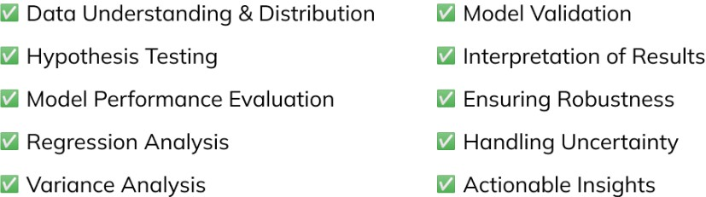
Understanding Statistics for Machine Learning
Statistics is the mathematical discipline of collecting, analyzing, interpreting, presenting, and organizing data.
It helps us understand uncertainty and variation in various fields through statistical analysis, often involving probability.
For instance, calculating the average marks of students in a class or surveying a sample of a city's population to estimate employment rates are real-life applications of statistics.
2

Slide 3
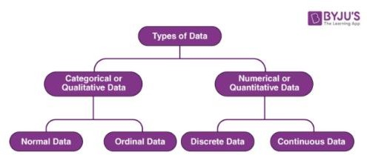
Types of Data
Data, a collection of facts like numbers, words, or observations, is categorized into four main types: Nominal, Ordinal, Discrete, and
Continuous.
Qualitative (Categorical) Data
Nominal Data
Labels variables without numerical value, used for classification. It cannot be ordered or measured. Examined by grouping data into categories to calculate frequency or percentage, often visualized with pie charts.
Ordinal Data
Follows a natural order, but differences between values are not quantifiable. Common in surveys or questionnaires, like satisfaction ratings. Typically represented using bar charts.
Describes data fitting into categories, not numerical. Examples include gender or hometown. Even if numerical, like birthdate, it lacks mathematical sense.
3

Slide 4
Interval and Ratio Scale Data
These numerical data types allow for meaningful comparisons, but differ in their zero points.
Interval Scale Data
Ratio Scale Data
Data Collection
Has a true zero point, allowing for meaningful ratios. If a value is zero, the variable is absent. Weight is an example: 10 kg is twice as heavy as 5 kg, and 0 kg means no weight.
Data is collected from a population (all members of a group) or a sample (a subset of the population). Samples are used when studying the entire population is not feasible, with statistical inference drawing conclusions about the population from the sample.
Differences between values are meaningful, but there's no true zero point. For example, temperature in Celsius: 0°C doesn't mean absence of temperature, so 20°C isn't "twice as hot" as 10°C.
4

Slide 5
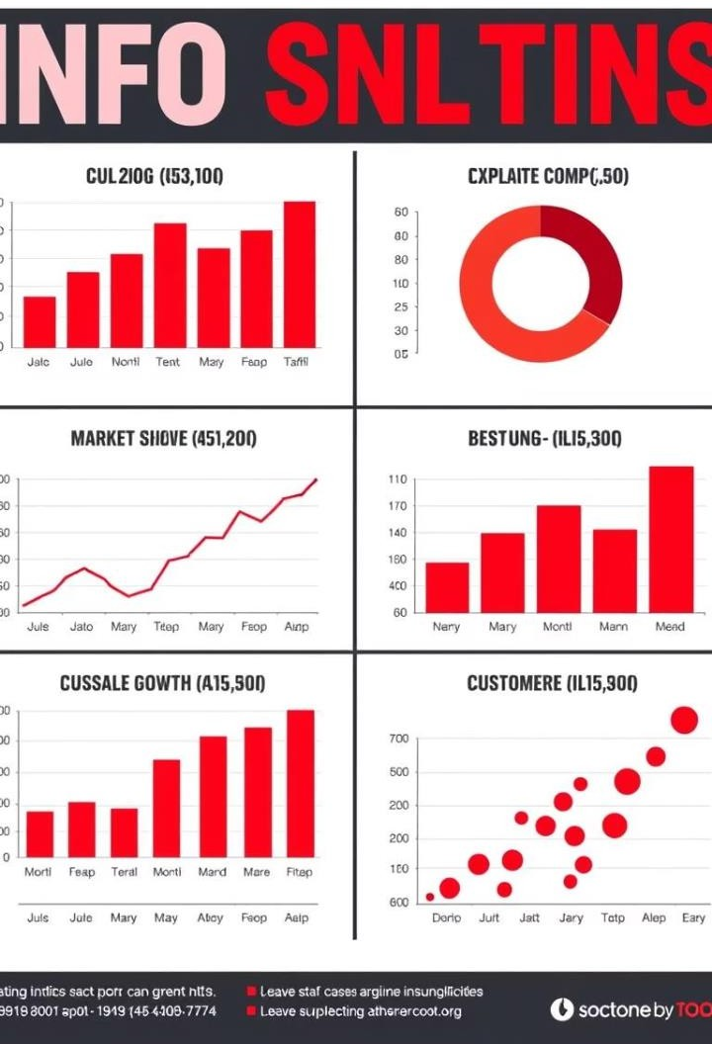




Descriptive Statistics
Descriptive statistics summarize and explain data from a population sample using measures like mean and standard deviation. They organize, represent, and explain data through charts, graphs, and summary measures.
Central Tendency
Variability (Spread)
Frequency Distribution
Identifies a representing distribution.
single the
value entire
Describes the occurrence of data within the data set, often represented by counts.
Describes the dispersion of the data set. Key measures are variance and standard deviation, showing how data points scatter from the mean.
Common
measures include mean (average), median (middle
value), and mode (most frequent value).
5

Slide 6
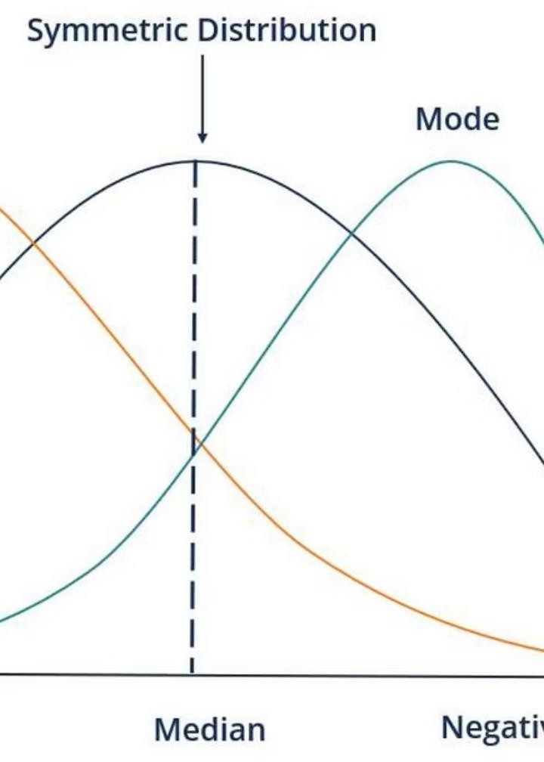


Understanding Skewness
Skewness measures the asymmetry of a distribution, indicating how much it deviates from a symmetrical normal distribution. A normal distribution has no skewness, with its mean, median, and mode being identical.
Positive Skewness (Right-Skewed)
The distribution is shifted to the left with a tail on the right side. The
mean is greater than the median, which is greater than the mode (Mean
> Median > Mode).
Negative Skewness (Left-Skewed)
The distribution is shifted to the right with a tail on the left side. The mean is less than the median, which is less than the mode (Mean < Median < Mode).
6

Slide 7
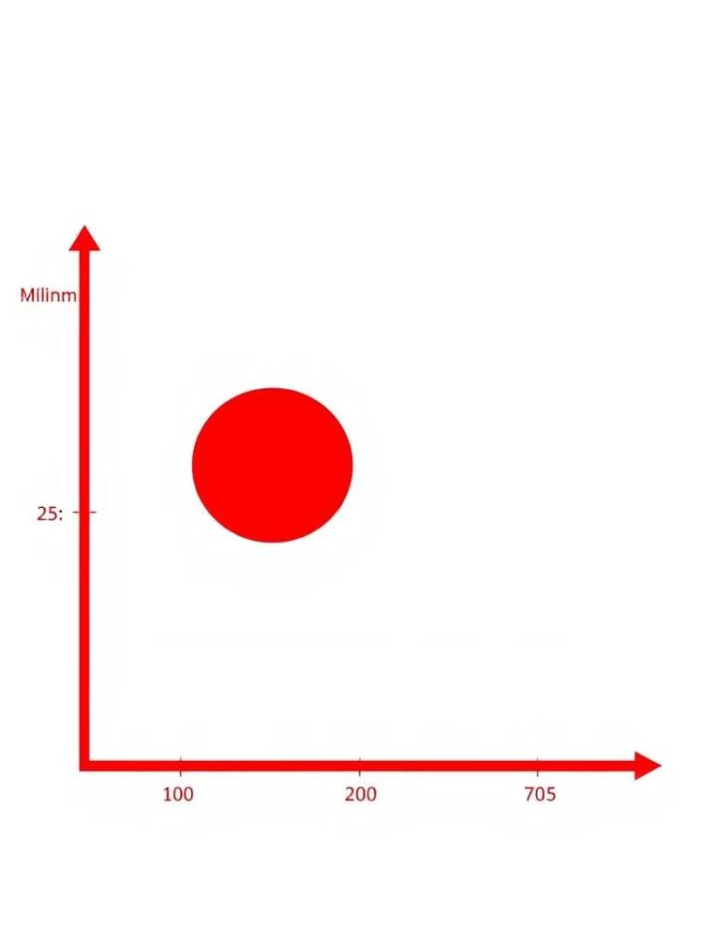
Percentiles and Quartiles
Percentiles indicate the value below which a certain percentage of data points lie. Quartiles divide a dataset into four equal parts, each containing 25% of the data.
2
Q2 (Second Quartile)
1
Q1 (First Quartile)
The 50th percentile, which is the median of the entire dataset.
The 25th percentile, marking the middle of the lower half of the data.
3
Q3 (Third Quartile)
The 75th percentile, marking the middle of the upper half of the data.
The five-number summary (minimum, Q1, median, Q3, maximum) provides a concise overview of data distribution, including its center, spread, and range, and is used in box plots to visualize these aspects and identify outliers.
7

Slide 8
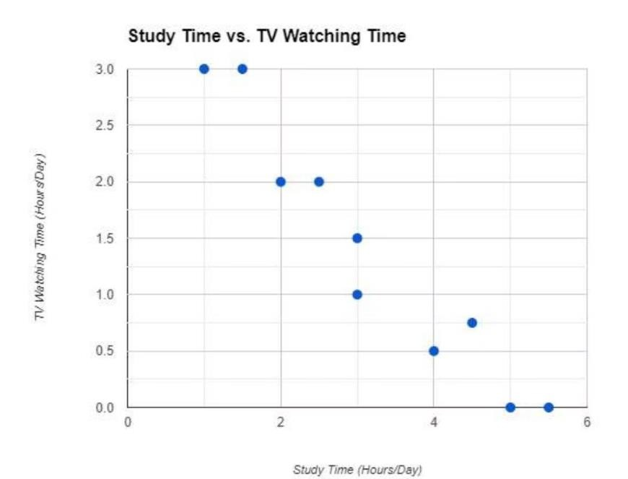
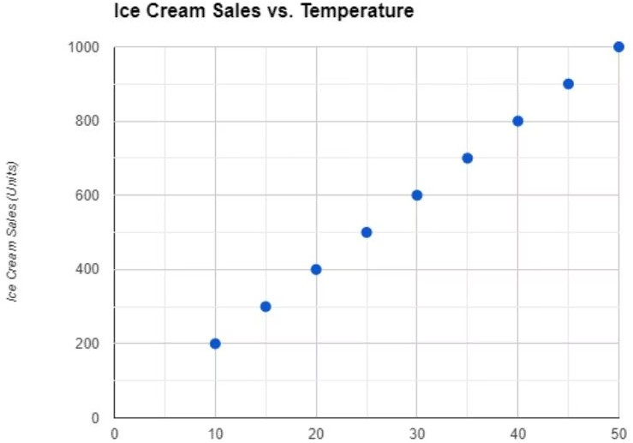
Correlation and Covariance
Correlation and covariance both measure the relationship between two variables, but they differ in what they quantify.
Covariance
Measures how much two variables change together. Positive covariance
means they move in the same direction, while negative means inverse.
Unlike correlation, it is measured in units and does not indicate the
strength of the relationship.
Correlation
Measures the strength and direction of a linear relationship between two variables, ranging from -1 (strong negative) to +1 (strong positive). It is a dimensionless value.
8

Slide 9
Hypothesis Testing and Distributions
Hypothesis testing determines if experimental results are meaningful by setting a null hypothesis (no difference) and an alternative
hypothesis (real effect). The p-value indicates statistical significance, compared to an alpha level.
Normal Distribution
1
Symmetrically distributed data with no skew, forming a bell curve. Mean, median, and mode are identical. The empirical rule (68-95-99.7) describes value distribution around the mean.
Log-Normal Distribution
2
Standard Normal Distribution
A normal distribution with a mean of zero and a standard deviation of one, converted using the Z-Score.
3
A continuous probability distribution where the logarithm of the random variable is normally distributed, often seen in wealth or salary distributions.
4
Power Law Distribution
A functional relationship where a relative change in one quantity results in a proportional relative change in another, often following the 80-20 rule.
9

Slide 10














Thank You!
Connect with Us!
We admonish you to live for God and connect with our community!
New Life Research Foundation (NELIREF) Ltd/Gte
Contact @neliref.org newliferesearchfoundation2013@gmail.com
www.neliref.org
+1 (678) 975-5615

